Slide 1


House

Slide 2
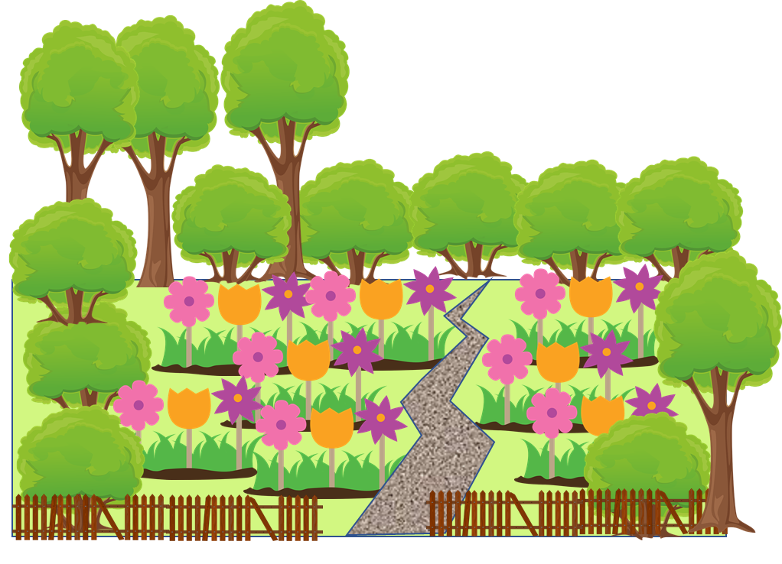
Garden

Slide 3

Road

Slide 4

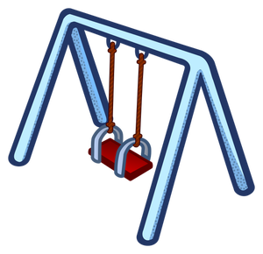
Playground

Slide 5

Car

Slide 6

Bus

Slide 7

Boat

Slide 8

Ship

